Slide 1
CW1

Slide 2
There follow three example slides (of the kind I expect you to submit), and then a description of the coursework.

Slide 3
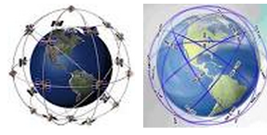
Scheduling Earth Observing Satellites with Evolutionary Algorithms http://alglobus.net/NASAwork/papers/SMCIT03/SMCIT02paper3.pdf
Example EC Application
An EOS fleet has specific observation
& image capture targets and is subject to
many constraints. This looks at two cases
involving 1 and 2 satellites in fixed orbits
Encoding: is a Permutation of ImageTasks – each is a specific area that must be observed once per day. A ‘scheduler’ routine then determines satellite ‘slews’ and other resources that have to be spent to achieve the requests in this order.
Fitness: in these simple cases, fitness was a combination of penalties for (i) unmet ImageTasks, (ii) total time slweing (ii) sum of slew angles. Hence this measured meeting of target with minimal wear and tear and optimised image quality.
Results: HC, SA and EA were compared on these simple cases; SA
was found best. Also, they found combined scheduling was better than independent scheduling of each satellite in a fleet

Slide 4
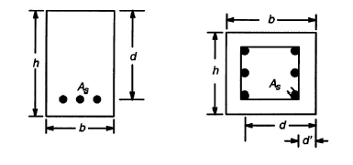
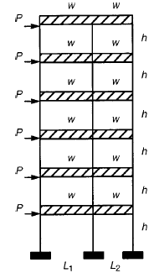
Design of Reinforced Concrete Frames using a Genetic Algorithm http://http://www.ce.memphis.edu/pezeshk/PDFs/camp_pezeshk_hakan.pdf
Example EC Application
Design dimensions and steel reinforcement params for structural beams meeting building constraints
Various test case scenarios looked at, including the six storey example on the right, inolving a set of RC elements
Encoding: simple list of numbers representing depth and height parameters, and number of placement of steel reinforcement sections.
Fitness: calculated with standard equations used by standards bodies
Results: They found that a simple GA worked adequately, leading to small reduction in structural costs while remaining safe and legal.

Slide 5
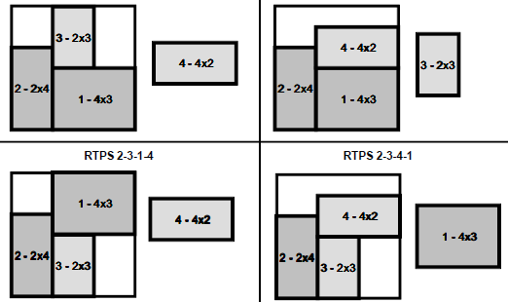
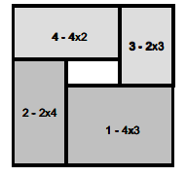
A genetic algorithm for 2D orthogonal packing http://www.research.att.com/techdocs/TD_7M7QJG.pdf
Example EC Application
Specific shapes (e.g. PVC, glass, plywood, ...) have to be cut from sheet with minimal waste. E.g. wasteful & optimal solutions shown on right.
Tested on many benchmark probs with size ranging from 10—100 shapes. Paper focuses on new fitness function which considers the empty rectangular spaces, aiming to help direct search towards sols that can be more likely improved by mutation.
Encoding: two permutations in each solution: (i) order of shapes (ii) order of plaement procedures – each of these is a choice from a small no. of simple heuristics.E.g. “BL” means close as poss to bottom left.
Results: New technique does very well, compared with a wide range of approaches on the same roblems

Slide 6
CW 1: BSc & 3rd/4th yr Meng Students
Produce THREE slides, each briefly describing a different application of evolutionary computation (or another bio-inspired approach) on an optimization problem. The previous three slides are examples of the type of thing I am looking for.
EACH SLIDE MUST: (i) contain a URL to a paper, thesis or other source that describes this application (ii) contain at least one graphic/figure (iii) simply and briefly explain key details of the problem, the encoding, the fitness function, and the findings in the paper.
HOW MUCH I EXPECT FROM YOU: Use google scholar, or maybe just google, and use sensible and creative search keywords. Don’t go overboard in the time you spend on this – e.g. I did not read in detail the papers summarised in the previous 3 slides. I just tried to grab the key ideas, and make up a slide that simply conveys the gist of them.
HAND IN: slide 1 by 23:59pm Sunday October 4th
I will give you marks and feedback by midnight October 18th
HAND IN: both slide 2 and slide 3 by 23:59pm Sunday October 25th

Slide 7
CW 1: MSc and 5th yr Meng Students
Produce TWO SETS of slides, each set containing TWO slides.
Each set of two slides will briefly describe the application of evolutionary computation (or other bio-inspired approaches) on a specific optimization problem of your choice. Each slide set will compare and contrast at least three different papers that solve the problem in different ways. The previous three slides are therefore NOT quite examples of the type of thing I am looking for.
EACH SLIDE SET MUST CONTAIN
On slide 1: (i) URLs to the three (or more) sources (paper, thesis or other sources) that describes an application to this problem (ii) a clear / succinct description/explanation of the problem (iii) at least one graphic/figure that helps explain the optimization problem
On slide 2: (i) bullet points that describe, compare and contrast the encodings and operators used in the three papers. (ii) bullet points that compare and contrast the results and findings
of the three papers.
HAND IN: slide set 1 by 23:59pm Sunday October 4th
I will give you marks and feedback by midnight October 18th
HAND IN: slide set 2 by 23:59pm Sunday October 25th

Slide 8
CW1: marking and handin
BSc students: Each slide will get 0, 1, 2 or 3 marks. There will be an additional 0 or 1 mark added for the ‘diversity’ among your three applications.
MSc and Meng 5th yr students: The first slide (or slide set) will get 0, 1, 2, 3 or 4 marks. The second slide (or slide set) will get 0, 1, 2, 3, 4, 5 or 6 marks.
When marking the second slide (or slide set) I will also take into account the difference between the two applications
Marking will consider how well your slide text and graphics conveys the things I am asking for, considering clarity, succinctness and correctness. When marking the second slide (or slide set) I will also take into account the difference between the two applications – e.g. you will lose up to two marks if both slidesets are about the same optimization problem.
To hand in, please email each individual slide in a separate message, as follows:
  send it to dwcorne@gmail.com
  include the slide (either ppt or pdf) as an attachment
  put your (real) name and degree programme (e.g. BSc CS, MSc AI, whatevs) in the body of the email
  Make the subject line: “BIC CW1 Slides N”, where N is either 1, 2, or ‘2 and 3’

